Slide 1


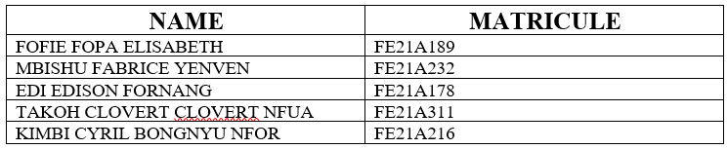
GROUP 25
CEF440
INTERNET PROGRAMMING AND MOBILE PROGRAMMING
Instructor: Dr NKEMINI Valery
APRIL 2024

Slide 2


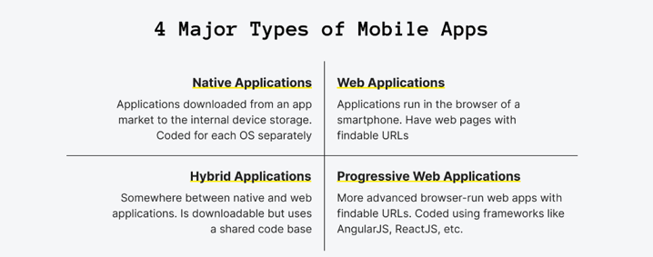
1.MAJOR TYPES OF MOBILE APPS AND THEIR DIFFERENCES (NATIVE, PROGRESSIVE WEB APPS, HYBRID APPS)
There exist various types of mobile applications which differ by purpose and the ways they operate on mobile devices
A mobile application is a kind of software that is created for being run on a mobile device. This includes not only smartphones but also tablets and smartwatches.

Slide 3
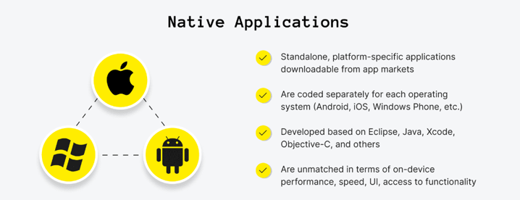
Native Applications
When building native apps developers have to code the app at least twice for Android and iOS so that the audience would have the chance to get it.
Native mobile apps are applications downloaded from an app market to the internal device storage. They are usually coded for each device separately.

Slide 4
Native Applications Advantages and Disadvantages
Advantages
1. Fast performance due to simple code specific to device and OS.
2. Better use of OS and device specific functionalities.
3. Interactive UI/UX.
4. Lesser compatibility issues and faster to configure.
Disadvantages
1. Building OS specific apps can be time-consuming
2. OS specific programming languages like swift and java are hard to learn.
3. Longer release cycles to ensure stability.
4. Requires separate codebase to add new features.
WhatsApp Messenger is a native app example.

Slide 5
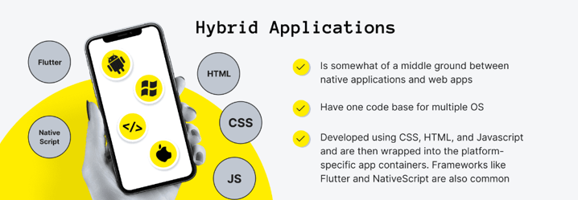
Hybrid Applications
Hybrid applications are also commonly developed using specially designed mobile application development frameworks like Flutter or React Native.
They are developed in one go for all platforms, which means less time and money spent on cross-platform development.

Slide 6
Hybrid Applications Advantages and Disadvantages
Advantages
1. Easy to build
2. Shareable code makes it cheaper than a native app
3. Easy to push new features since it uses a single code base.
4. Can work offline.
5. Shorter time to market, as the app can be deployed for multiple OSs.
Disadvantages
1. Complex apps with many functions will slow down the app.
2. More expensive than web apps
3. Less interactive than native apps
4. Apps cannot perform OS specific tasks
There are tons of hybrid applications today, including Instagram, Gmail, Facebook, and many others.

Slide 7
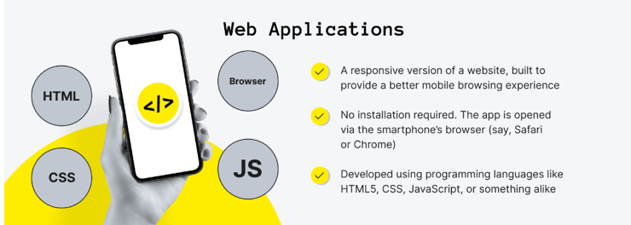
Web Applications
Mobile websites are the version of a website that people see when opening a site from a mobile browser, but they are commonly unoptimized, not user-friendly, slow, and look like the shrunk desktop website version.
Web apps are a responsive version of a website, built to provide a better mobile browsing experience when compared to using the website's regular mobile version.

Slide 8
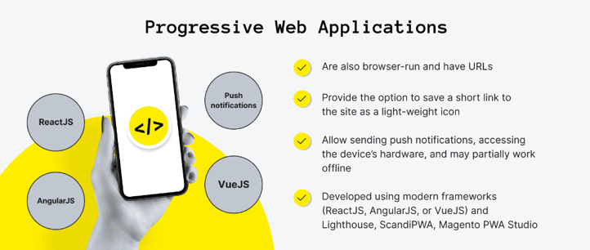
Progressive Web Applications
Progressive web apps are built using modern frameworks like React.js, Angular.js, or Vue.js.
They are typically accessed via a web browser of your choice but can be installed and accessed on a device.

Slide 9
Progressive Web Applications Advantages and Disadvantages
Advantages
1. They use very little data
2. PWAs get updated like web-pages. They automatically get updated every time you use them.
3. There is no need for installation as PWAs are simple web-pages.
4. You can easily share PWAs by simply sending its URL.
Disadvantages
1. There are limitations to using all the Hardware and Operating Systems features.
2. PWAs can pose a few hardware integration problems.
3. Full support is not available in default browsers of some of the manufacturer’s.
4. It cannot use the latest hardware advancements (like fingerprint scanner).
The implementation of progressive web apps has been especially seen in the e-commerce sector recently.

Slide 10

2. MOBILE PROGRAMMING LANGUAGES
Selecting the proper programming language is crucial when creating apps for a variety of reasons.
Your app’s functionality, performance, scalability, maintainability, and developer productivity will all be significantly impacted by the programming language you choose.

Slide 11
2. Best Programming Languages for Mobile App Development
1. Swift
Developed by Apple, Swift is the go-to language for iOS app development.
2. Kotlin
Kotlin has gained popularity for Android app development due to its interoperability with Java and concise syntax.
3. Java
Java remains a robust choice for Android app development. Its platform independence, strong community support, and extensive libraries make it a versatile language.
4. Dart (used with Flutter)
Dart, paired with Google’s Flutter framework, enables cross-platform app development with native-like performance.
5. JavaScript (used with React Native)
React Native leverages JavaScript to build cross-platform mobile apps with a single codebase. Its component-based architecture and hot reloading feature accelerate development.

Slide 12
2. Best Programming Languages for Mobile App Development
6. C# (used with Xamarin)
Xamarin, powered by C#, allows developers to build native Android, iOS, and Windows apps with a shared codebase.
7. Python
Python’s simplicity and versatility extend to mobile app development, particularly with frameworks like Kivy and BeeWare. Its readable syntax and extensive libraries facilitate rapid prototyping and development.
8 HTML/CSS
Web technologies like HTML and CSS, combined with frameworks like Cordova and PhoneGap, enable the building of hybrid mobile apps. Their familiarity and ease of use make them accessible to web developers.
9 Rust
Rust’s focus on safety and performance makes it a compelling choice for mobile app development, especially for resource-intensive applications.
10. Ruby
Although primarily associated with web development, Ruby can be used for mobile app development with frameworks like RubyMotion.

Slide 13
3. MOBILE DEVELOPMENT FRAMEWORKS
3.1 React Native
Developed by Facebook, React Native enables developers to create mobile apps using JavaScript and React, facilitating cross-platform development for iOS and Android from a single codebase. Additionally, React Native provides a platform for web application development.
3.2 Flutter
Developed by Google, Flutter is an open-source UI software development kit designed for crafting natively compiled applications across mobile, web, and desktop platforms, all from a unified codebase.
3.3 Xamarin
Developed by Microsoft, Xamarin is a framework that allows developers to build cross-platform mobile apps using C#. It leverages the .NET framework and provides access to native APIs, offering high performance and native-like user experiences.

Slide 14
3. MOBILE DEVELOPMENT FRAMEWORKS
3.4 Ionic
Ionic is an open-source framework that uses web technologies such as HTML, CSS, and JavaScript to build cross-platform mobile apps. It utilizes AngularJS for application logic and provides a library of pre-designed UI components.
3.5 PhoneGap / Apache Cordova
PhoneGap, now known as Apache Cordova, is a framework that enables the development of mobile apps using web technologies. It wraps HTML, CSS, and JavaScript code into a native container, allowing developers to access device features through plugins.
3.6 NativeScript
Developed by Progress, NativeScript is an open-source framework for building native mobile apps using JavaScript or TypeScript. It provides access to native APIs and UI components, allowing developers to create truly native experiences.
3.7 SwiftUI
Introduced by Apple, SwiftUI is a framework for building user interfaces across all Apple platforms, including iOS, macOS, watchOS, and tvOS. It enables developers to create declarative UIs using Swift, reducing boilerplate code and enhancing productivity.

Slide 15
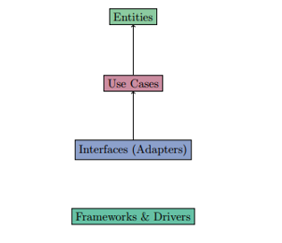
4. MOBILE DEVELOPMENT ARCHITECHTURE AND DESIGN PATTERN
4.1 Model-View-Controller (MVC)
The Model-View-Controller architecture separates an application into three interconnected components.
4.2 Model-View-ViewModel (MVVM)
MVVM extends the MVC pattern with a stronger separation of concerns. The Model remains responsible for data and business logic, while the View is responsible for UI rendering.
4.3 Model-View-Presenter (MVP)
MVP is another variation of MVC, emphasizing a passive view. The Model represents the application's data and logic, while the View renders the UI and forwards user input to the Presenter.
4.4 Clean Architecture
Clean Architecture, proposed by Robert C. Martin, emphasizes separation of concerns and layers with clear dependencies.

Slide 16
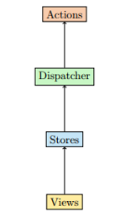
4. MOBILE DEVELOPMENT ARCHITECHTURE AND DESIGN PATTERN
4.5 Flux Architecture
Developed by Facebook for React applications, Flux is an architectural pattern that emphasizes unidirectional data flow.
4.6 Redux
Redux is a predictable state container commonly used with React applications. It centralizes the application state in a single store and uses pure functions called reducers to update the state in response to actions.
4.7 VIPER (View, Interactor, Presenter, Entity, Router)
VIPER is an architectural pattern derived from Clean Architecture, with additional components for handling navigation and user interactions.

Slide 17
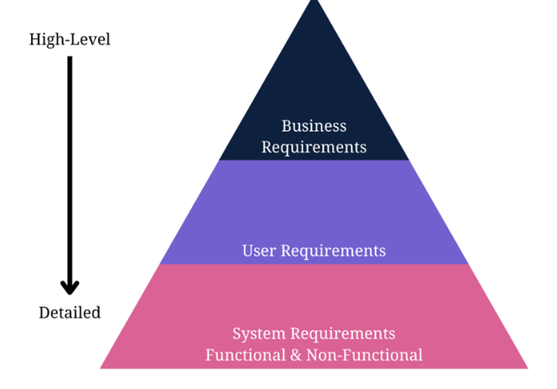
5. USER REQUIREMENTS FOR MOBILE APP
Mobile apps have different requirement types to collect, including:
Business requirements are high-level requirements that ensure the app will align with business objectives, and the project’s scope, and identify the key stakeholders.
User requirements are valuable insights into what your target audience needs and wants, how you can solve their problems, and what the audience experiences from your prototyping app.
Product or system requirements are non-functional requirements and functional requirements that include technical requirements and technical specifications for the engineering team.

Slide 18
5. USER REQUIREMENTS FOR MOBILE APP
5.1: Define Your App Idea and Purpose
Mobile development requirements-gathering starts with a business idea. The first information you need is the idea or purpose of the mobile app.What purpose will it serve? Does it offer a solution to a potential problem?
5.2 Gather and Align the App and Business Objectives or Goals
An app idea is fruitless without understanding business needs, business goals, and business rules.
5.3 Run a Market Analysis and Competitor Analysis
Conduct a market or competitor analysis to truly understand the user’s perspective and design the appropriate user personas.
It also helps the team gather more user requirements for the development company.
5.4 Determine Scenarios and a User Persona
The next major step in mobile app requirements-gathering is to design user personas and scenarios to guide the requirements.
A user persona functionalizes the target users for the mobile app.

Slide 19
5. USER REQUIREMENTS FOR MOBILE APP
5.5 Gather and Prioritise Functional and Non-Functional Requirements
Your user and business requirements are shaped through the initial steps of app requirements gathering.
You still need to document them, but you’ll do that soon enough.
5.6 Design Use Cases and User Stories
A mobile system requirements document won’t be complete unless you add use cases and stories.
Design them before documenting the specifications for the development company or team.
Use stories and cases to add visual representation to your documents for mobile app development documentation.
5.7 Write an App Requirements Document
Formulate the App’s Idea Statement
Every app requirements document should include an idea statement that lets every stakeholder and software developer understand the document before diving into the details.
5.8 Deploy Prototyping and Wireframing
Prototyping and wireframing let you design the user flow of user interfaces and basic app functions.
It also lets you test and validate layouts and transitions between app pages.

Slide 20
5. USER REQUIREMENTS FOR MOBILE APP
5.9 Validate the App Requirements
Validation is a quality control process you use before launching the final product based on your requirements.
The prototype app collects feedback from stakeholders, and you can invite stakeholders to verify that the app meets the documented requirements.
5.10 Apply Agile Methodology
Agile methodology in requirements-gathering means you’ll always adapt the requirements document as per the feedback from stakeholders, testing, and initial product releases.
Agile methodology focuses on user experience and constant testing and validation to further improve your application.

Slide 21
6. ESTIMATING MOBILE DEVELOPMENT COST
Define Your App’s Objective and Features
To estimate the cost of your app, start by determining its goal and features. What do you want your app to achieve?
6.2 Choose the Platform
Deciding between iOS, Android, or both platforms is crucial for determining development costs. Developing separate apps for each platform requires more resources compared to creating a cross-platform app.
6.3 Evaluate App Design Complexity
The design of your app plays a significant role in its appeal and usability. Consider whether your app would benefit from a simple and minimalistic design or a more elaborate and visually captivating interface.
6.4 Estimate Development Hours
Once you have a clear understanding of your app’s features and design, estimate the number of development hours needed for each task. Break down the project into smaller components and allocate hours based on complexity.

Slide 22
6. ESTIMATING MOBILE DEVELOPMENT COST
6.5 Research Development Rates
Hourly rates for mobile app development vary depending on regions and development teams. Take the time to research average rates in major cities
6.6 Consider Additional Expenses
In addition to development hours, there are other costs to consider. Quality assurance and testing are essential for ensuring all features and functionality of the application work as intended across different device types and operating system versions
6.7 Include a Contingency Budget
Unexpected challenges like changes to project scope, integration issues between features, or bugs that take significant time to resolve can arise during development, leading to delays and extra expenses

